Slide 1
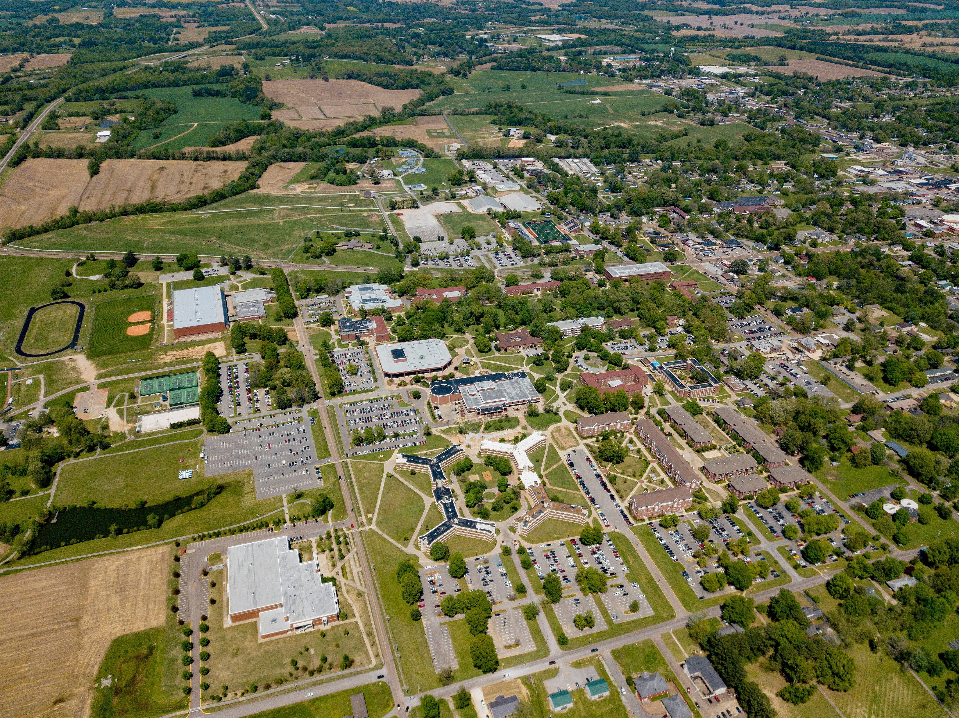
University Advancement Report to the UT Martin Advisory Board
“We Are The Peddlers Of Hope”
Division of University Advancement
Alumni Development Advancement Services

Slide 2
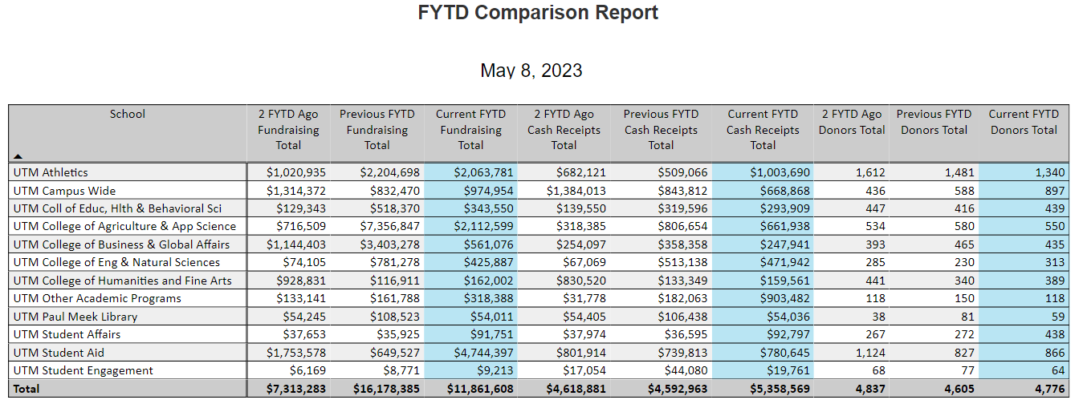
2023 Review
The following are the goals as set by the UT Foundation Board of Directors for overall fundraising:
Total Gift Goal $17,000,000 Stretch Goal $21,250,000
Number of Donors Goal 4,900 Stretch Goal 5,100
Total raised to date $11,861,608 from 4,776 donors

Slide 3
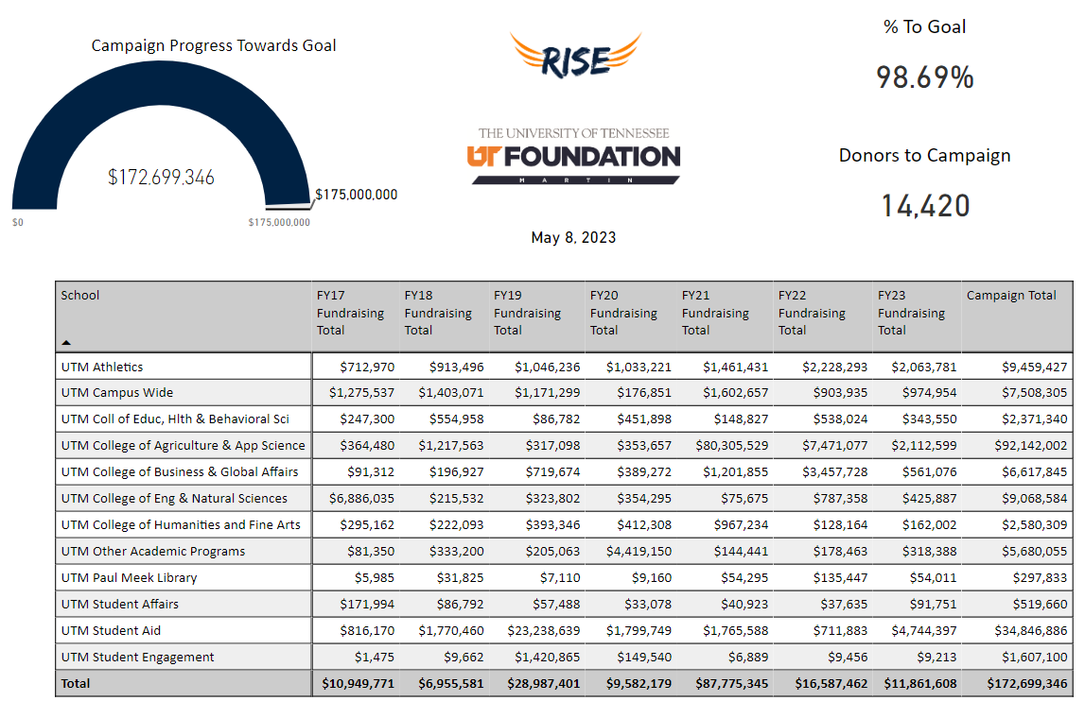

Slide 4
Year | Total Amount | Donors |  | AG
2012 | $2,000,000 | 2,571 |  | $200,229
2013 | $3,000,000 | 2,862 |  | $258,372
2014 | $3,000,000 | 3,215 |  | $356,156
2015 | $4,000,000 | 3,687 |  | $522,321
2016 | $4,000,000 | 4,068 |  | $722,659
2017 | $11,000,000 | 3,890 |  | $634,962
2018 | $7,000,000 | 4,279 |  | $757,281
2019 | $29,000,000 | 4,649 |  | $693,998
2020 | $10,000,000 | 5,143 |  | $844,367
2021 | $87,000,000 | 5,001 |  | $882,599
2022 | $17,000,000 | 4,833 |  | $857,839
2023FYTD | $11,861,608 | 4,776 |  | $739,465
Avg | $ 15,738,467 | 4081 |  | $ 622,521

Slide 5
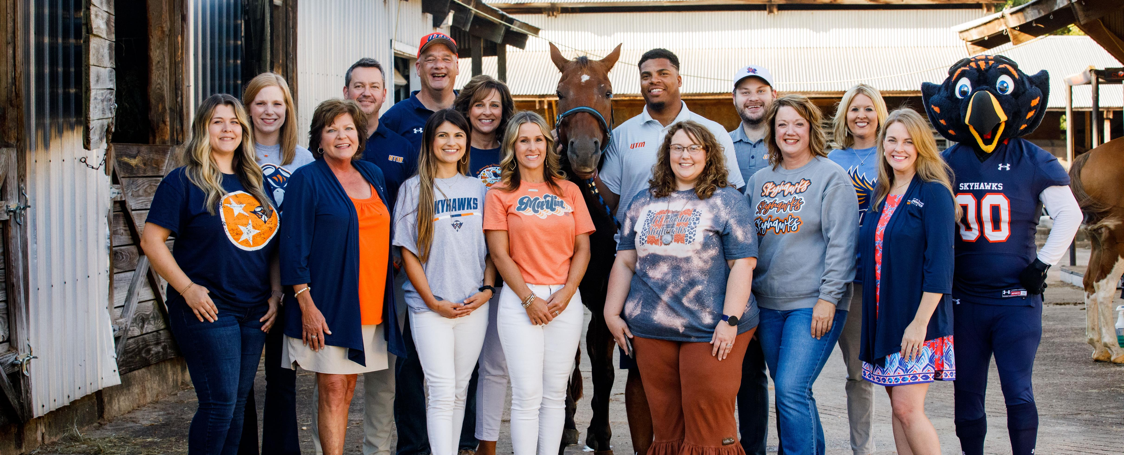
2023 and beyond…
Complete RISE Campaign
Planning for next campaign
Building endowment to $100 million by 2030
Celebrating 100th year of organized athletics
Planning for 125th anniversary of our university founding
Continue to seek innovative ways to increase revenue for the foundation and the university

